Slide 1

Social decision-making journal club
Thank Dr. Michael Hallquist, director of the DEPENd lab, for sharing this reading list!
The DEPENd lab studies personality functioning using decision neuroscience.
You are welcome to visit
our lab website for more
details!

Slide 2
近期安排
下周两次报告时间
周三、周五（1月19日和1月21日）北京时间晚上9点
下下周开始报告时间改为每周周二和周五报告

Slide 3
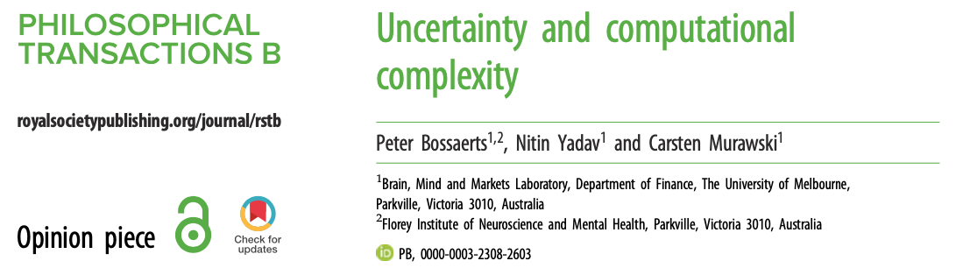
主讲人：马若璠 | Presenter: Ma, Ruofan
2022年1月14日 | Jan 14th, 2022
Find me on: Google Scholar | ResearchGate | Twitter @ma_ruofan

Slide 4
The Savage framework
Modeling uncertainty in decision-making
Savage framework
States of the world represented by probabilities
Several axioms

Slide 5
The Savage framework
Axioms of rationality = basic properties obeyed by every rational decision-maker
Core of the framework

Slide 6
The Savage framework
Axiom 1 establishes completeness of preferences
F: S → C
If s is the agent’s state, then ∀ s ∈ S and f ∈ F₀, ∃ c = f(s)
S is the set of possible states of the world
C is the set of consequences of a given action
F₀ is a set of actions (concrete acts)
F the set of all mappings (acts) from S to C
Axiom 1: Preferences are binary relations over choice options (e.g., apple >= banana), and the agent defines preferences for the entire choice set
Assumes that agents rank all acts (i.e., elements of F) available to them

Slide 7
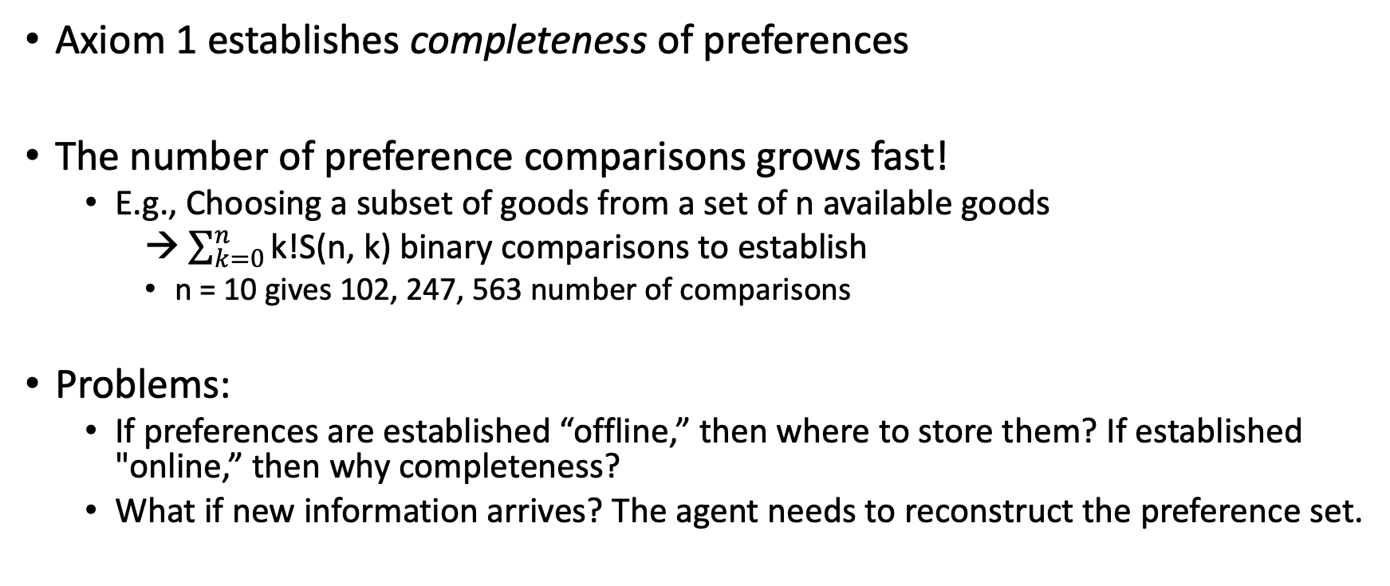
The Savage framework
Axiom 1 establishes completeness of preferences
The number of preference comparisons grows fast!
E.g., Choosing a subset of goods from a set of n available goods
$\sum_{k=0}^{n}{\text{k}\text{!}\text{S}\text{(}\text{n}\text{, }\text{k}\text{)}}$ binary comparisons to establish
n = 10 gives 102, 247, 563 number of comparisons
Problems:
If preferences are established “offline,” then where to store them? If established "online,” then why completeness?
What if new information arrives? The agent needs to reconstruct the preference set.
Notes:
a Stirling number of the second kind is the number of ways to partition a set of n objects into k non-empty subsets

Slide 8
The Savage framework
Axioms 2, 3, 4 establish the separability of belief and value: the agents’ beliefs and values can always be disentangled
Assumes that agents can track beliefs and values separately
This ability is assumed to be central to rationality
Defining null A ⊆ S
Let f_{A} be the restriction of the mapping f to the set A, ∀ f ∈ F and ∀ A ⊆ S
Then A is null if
f_{A^C} ~ g_{A^C} => f ~ g, where f, g ∈ F and A^C is the complement of A
The agent is indifferent towards states in A (i.e., preferences are not influenced by the consequences they have for states in A)
Implication is that the true state of the world is not in A
The constant act [c] is a [c] ∈ F such that, ∀ s ∈ S, [c] maps s → c for a c ∈ C

Slide 9
The Savage framework
Axiom 2: the sure-thing principle
If two acts agree on A^C, then the choice between the acts should only depend on how they differ on A but not on how they agree on A^C
The most controversial axiom
Ellsberg paradox: ambiguity/uncertainty aversion (people prefer choices that have known risks than uncertain risks)

Slide 10
The Savage framework
Axiom 3: If an agent prefers d to c in general, then the agent prefers d in every event A (given that A is not null)/ every state of the world
Preferences are independent of belief/state of the world
Ensures that value can be separated from belief
Axiom 4: Value is independent of belief; the only explanation for f < g is that the agent thinks B is more likely than A
Assumes that belief can be discovered from preference
Criticism: The agent has to construct the state space (S) and set of consequences (C) to be suitable for a decision task
Not obvious how this could be done

Slide 11
The Savage framework
The axioms imply that “an agent’s preferences among acts [observable behaviours] can be represented by subjective expected utility.”

Slide 12
Example 1 Selection of securities
Need to choose 3 out of 10 securities
Each security has pay off = $1 or $0, with 50% probability
30 periods to learn the types of the securities: 2^{10 * 30} different states
Signal shows:
P(positive | $1) = 0.7, P(negative | $1) = 0.3
P(positive | $0) = 0.3, P(negative | $0) = 0.7
After signal, agent uses Bayes’ Law to update beliefs about the final pay-offs
Preferences/choices (observable) reveal beliefs (unobservable)
The agent needs to express preferences over all possible states

Slide 13
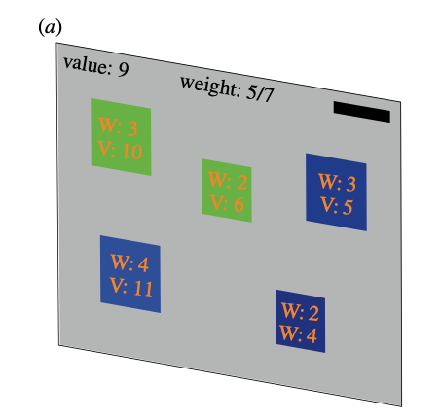
Example 2 Backpacking
Choose a subset of items from 10 items that are (value, weight) pairs
Goal: maximize total value; weight <= 265
Each item has a security pay-off= $1 if item is in the optimal solution
Can sample different combinations of items before deciding
State = a combination of pay-offs; Consequence = $ amount of a state

Slide 14
Computational complexity
Complexity class
P
Takes resources (e.g., an amount of time) polynomial in n to solve
Tractable (solved efficiently)
NP
Can be efficiently verified but not necessarily solved efficiently
NP-hard
Problems that are at least as hard as the hardest problems in NP; Intractable
Can be tractable for certain values of input parameters
The general version of Example 2 on the previous slide
NP-complete
The class of the hardest problems in NP

Slide 15
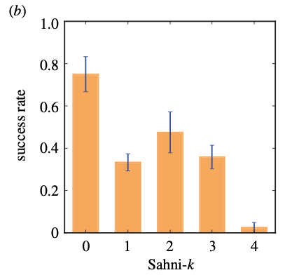
Computational complexity and human decision-making
Evidence: Murawski & Bossaerts, 2016, Sci. Rep.
Paradigm similar to Example 2
Sahni-k: k is the cardinality of the “pre”-computed subsets of the items
Higher k → higher computational complexity/required computational resources of the instance
Finding: Participants’ ability to find the solution of an instance decreases as the value of Sahni-k increases (i.e., as computational complexity increases)

Slide 16
Limits of the Savage framework | Tractability
Completeness axiom
Agents have to make binary comparisons of all available acts, and the number of comparisons can be very large
Many decision tasks are computationally intractable
Knapsack problem (similar to Example 2) is NP-hard
Can’t assume humans can overcome a problem’s computational complexity
Beliefs (and values) are only used to represent preferences
Completeness of preferences is intractable => inference of beliefs impossible
Belief/preference updating following Bayes’ Law can be computationally intractable
Conclusion: “Savage framework is computationally intractable not only from the perspective of completeness, but also from the perspective of maintaining a set of beliefs consistent with Bayes’ Law.”

Slide 17
Limits of the Savage framework | Effectiveness
Example 1: Uncertainty due to randomness
Uncertainty is probabilistic; probabilities can be learned by sampling
Belief updating is tractable (in class P)
Example 2: Uncertainty due to computational complexity
Uncertainty is not probabilistic; it arises from the high degree of computational resources required to compute the optimal solution
Using the Savage framework, probabilities = the degree of belief that a certain subset of items is the optimal solution
Listing all the 82 possibilities is faster than using random sampling to reduce uncertainty
“The Savage framework is only effective in representing a particular type of uncertainty… uncertainty that can effectively be represented by probabilities.”

Slide 18
Limits of the Savage framework | Implications for modeling of decisions
Suggested to be a generic framework that can capture any decision situation
Decision theories inspired by it all assume that the agent behaves optimally, maximizing a weighted average of utilities over states
Plausible decision-making models need to solve a task without exceeding the decision-maker’s computational capacities
Need frameworks that allow more general representations of knowledge than probability representations

